Slide 1
PHDL Printed Circuit Board Hardware Description Language
Brent Nelson, Brad Riching, Richard Black
Dept. of Electrical and Computer Engineering
Brigham Young University
October 25, 2011

Slide 2
Acknowledgements
Pete Dudley – Sandia
Ideas, motivation, and passion for this project
Wes Landaker - Sandia
Ideas, language design, compiler consulting
Sandia Management
Funding

Slide 3
Overview
Who are we?
What is PHDL? (a very short intro)
Examples of PHDL
Example board designs
Language and grammar
Tool flow
What is PHDL? (more in-depth)
Why textual input?

Slide 4
Who Are We?
Dr. Brent Nelson
Brigham Young University, Dept. of Electrical and Computer Engineering
Brad Riching
MS Student in Computer Engineering
BS in Electrical Engineering, Brigham Young University, 2010
Richard Black
Undergraduate in Computer Engineering, Brigham Young University

Slide 5
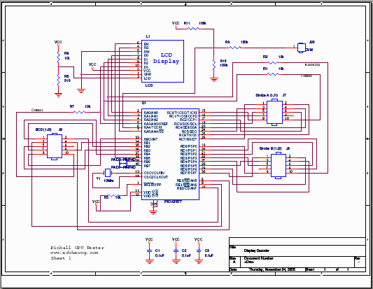
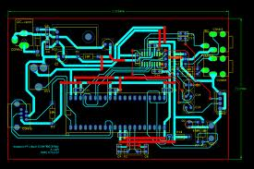
What is PHDL?
PCB Layout interprets netlist
Schematic Capture produces netlist
netlist
Bill of Material, other ancillary data

Slide 6
What is PHDL?
PCB Layout interprets netlist
Schematic Capture produces netlist
netlist
netlist
PHDL compiler
Bill of Material, other ancillary data
PHDL Source Code

Slide 7
What is PHDL? (a very short intro)
An HDL for PC Boards
Hardware Description Language
For schematic entry (not layout)
Similar to HDLs for IC and FPGA design
Verilog, VHDL, etc.
Goal == significantly increase:
Productivity
Collaboration
Reuse

Slide 8
Why PHDL? (the short version)
Automation & productivity
Iteration, hierarchy, ERC/DRC
Collaboration
SCCS (source code control system)
Shared repository for designs and part libraries
Design versions, change tracking/documentation
Diff, revert
Textual IDEs and tools
Templates, auto-completion, search and replace, library reuse

Slide 9
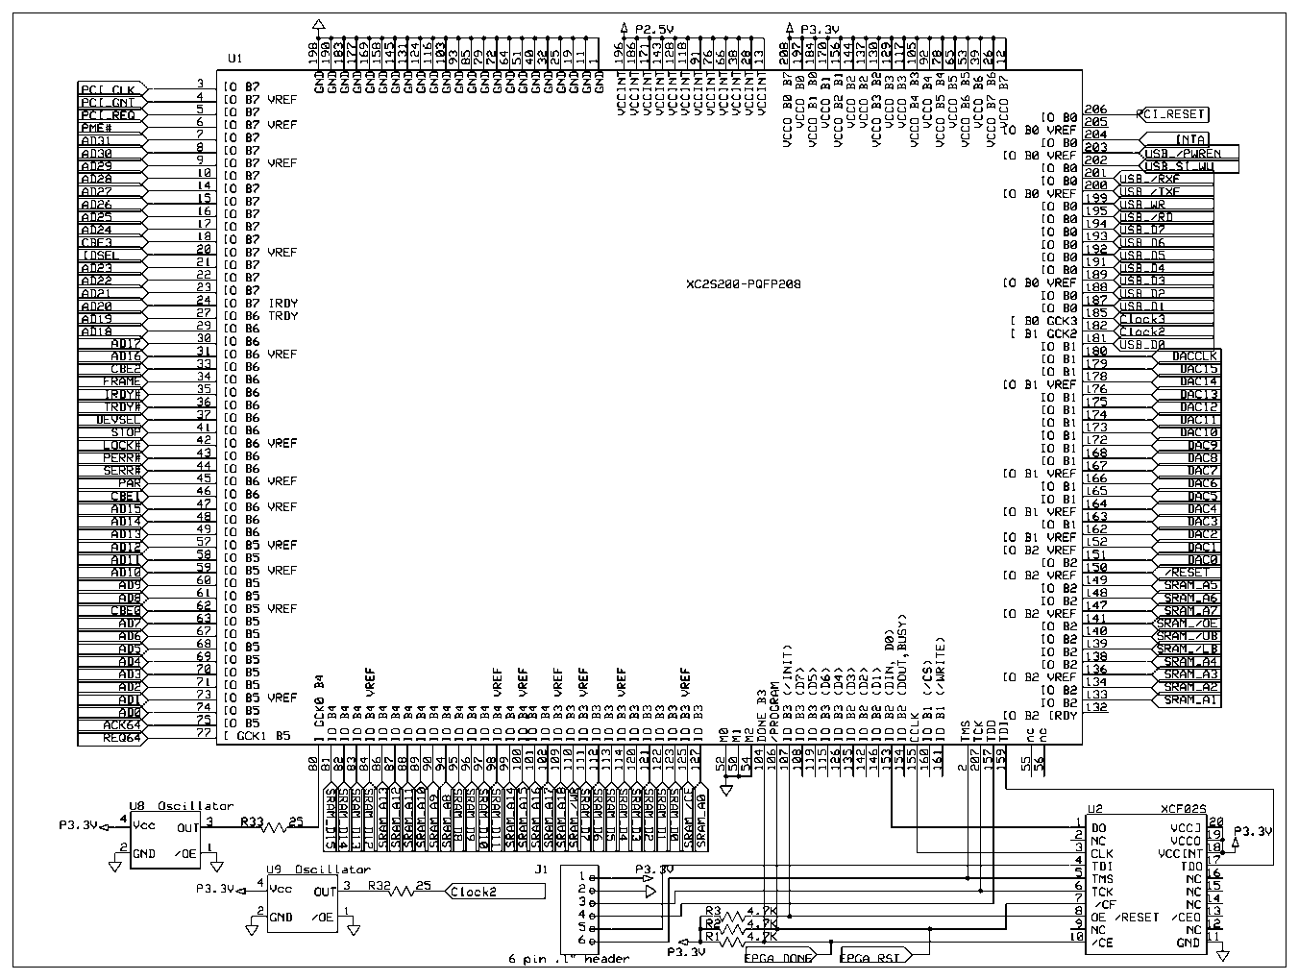
High Pin Count Devices - FPGAs
How much of this schematic is meaningful?
Most circuit context is absent.
Many pins map to devices on other pages.
Larger devices must be split across multiple pages
Schematics don’t scale well.
HDL’s do!

Slide 10
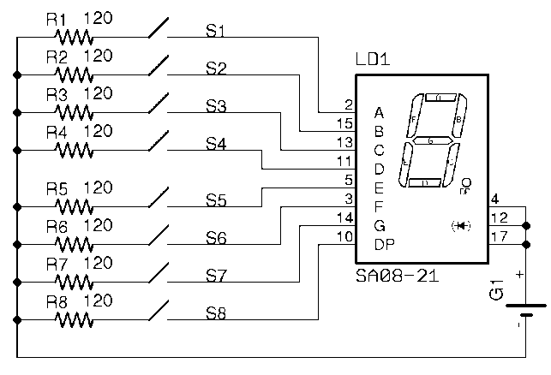
Trivial Example
We’ll illustrate some of the features of PHDL with an example:

Slide 11
Trivial Example
We’ll illustrate some of the features of PHDL with an example:

Slide 12
Trivial Example
We’ll illustrate some of the features of PHDL with an example:

Slide 13
Trivial Example
We’ll illustrate some of the features of PHDL with an example:

Slide 14
Trivial Example
We’ll illustrate some of the features of PHDL with an example:

Slide 15
Trivial Example
We’ll illustrate some of the features of PHDL with an example:

Slide 16
Trivial Example
We’ll illustrate some of the features of PHDL with an example:

Slide 17
Trivial Example
We’ll illustrate some of the features of PHDL with an example:

Slide 18
Trivial Example
We’ll illustrate some of the features of PHDL with an example:

Slide 19
PHDL Example Design
design ssControl is
device Resistor is
attr refPrefix = “R”;
attr pkg_type = “M0805”;
pin a = {1};
pin b = {2};
end device;
device Switch is
attr refPrefix = “SW”;
attr pkg_type = “MS243”;
pin a = {1}; pin b = {2};
end device;
device Battery is
attr refPrefix = “G”;
attr pkg_type = “1V60R”;
attr value = “9V”;
pin pos = {2}; pin neg = {1};
end device;
device SevenSeg is
attr refPrefix = “LD”;
attr pkg_type = “MS243”;
pin[1:8] segments = {2,15,13,11, 5,3,14,10};
pin[1:3] anode = {4,12,17};
end device;
net gnd, vcc;
net[1:8] segs, r2sw;
begin
inst source of Battery is
pos = vcc;
neg = gnd;
end inst;
inst segment of SevenSeg is
segments = segs;
anode = <vcc>;
end inst;
inst(1:8) swArray of Switch is
combine.a = r2sw;
combine.b = segs;
end inst;
inst(1:8) rArray of Resistor is
newattr value = “120”;
combine.a = r2sw;
each.b = gnd;
end inst;
end design;

Slide 20
PHDL Example Design
design ssControl is
device Resistor is
attr refPrefix = “R”;
attr pkg_type = “M0805”;
pin a = {1};
pin b = {2};
end device;
device Switch is
attr refPrefix = “SW”;
attr pkg_type = “MS243”;
pin a = {1}; pin b = {2};
end device;
device Battery is
attr refPrefix = “G”;
attr pkg_type = “1V60R”;
attr value = “9V”;
pin pos = {2}; pin neg = {1};
end device;
device SevenSeg is
attr refPrefix = “LD”;
attr pkg_type = “MS243”;
pin[1:8] segments = {2,15,13,11, 5,3,14,10};
pin[1:3] anode = {4,12,17};
end device;
net gnd, vcc;
net[1:8] segs, r2sw;
begin
inst source of Battery is
pos = vcc;
neg = gnd;
end inst;
inst segment of SevenSeg is
segments = segs;
anode = <vcc>;
end inst;
inst(1:8) swArray of Switch is
combine.a = r2sw;
combine.b = segs;
end inst;
inst(1:8) rArray of Resistor is
newattr value = “120”;
combine.a = r2sw;
each.b = gnd;
end inst;
end design;

Slide 21
PHDL Example Design
design ssControl is
device Resistor is
attr refPrefix = “R”;
attr pkg_type = “M0805”;
pin a = {1};
pin b = {2};
end device;
device Switch is
attr refPrefix = “SW”;
attr pkg_type = “MS243”;
pin a = {1}; pin b = {2};
end device;
device Battery is
attr refPrefix = “G”;
attr pkg_type = “1V60R”;
attr value = “9V”;
pin pos = {2}; pin neg = {1};
end device;
device SevenSeg is
attr refPrefix = “LD”;
attr pkg_type = “MS243”;
pin[1:8] segments = {2,15,13,11, 5,3,14,10};
pin[1:3] anode = {4,12,17};
end device;
net gnd, vcc;
net[1:8] segs, r2sw;
begin
inst source of Battery is
pos = vcc;
neg = gnd;
end inst;
inst segment of SevenSeg is
segments = segs;
anode = <vcc>;
end inst;
inst(1:8) swArray of Switch is
combine.a = r2sw;
combine.b = segs;
end inst;
inst(1:8) rArray of Resistor is
newattr value = “120”;
combine.a = r2sw;
each.b = gnd;
end inst;
end design;

Slide 22
Creating a Design
device Resistor is
attr refPrefix = “R”;
attr pkg_type = “M0805”;
pin a = {1};
pin b = {2};
end device;
1
R?
M0805
2

Slide 23
Creating a Design
device Resistor is
attr refPrefix = “R”;
attr pkg_type = “M0805”;
pin a = {1};
pin b = {2};
end device;
1
R?
M0805
2

Slide 24
Creating a Design
device Resistor is
attr refPrefix = “R”;
attr pkg_type = “M0805”;
pin a = {1};
pin b = {2};
end device;
1
R?
M0805
2

Slide 25
PHDL Example Design
design ssControl is
device Resistor is
attr refPrefix = “R”;
attr pkg_type = “M0805”;
pin a = {1};
pin b = {2};
end device;
device Switch is
attr refPrefix = “SW”;
attr pkg_type = “MS243”;
pin a = {1}; pin b = {2};
end device;
device Battery is
attr refPrefix = “G”;
attr pkg_type = “1V60R”;
attr value = “9V”;
pin pos = {2}; pin neg = {1};
end device;
device SevenSeg is
attr refPrefix = “LD”;
attr pkg_type = “MS243”;
pin[1:8] segments = {2,15,13,11, 5,3,14,10};
pin[1:3] anode = {4,12,17};
end device;
net gnd, vcc;
net[1:8] segs, r2sw;
begin
inst source of Battery is
pos = vcc;
neg = gnd;
end inst;
inst segment of SevenSeg is
segments = segs;
anode = <vcc>;
end inst;
inst(1:8) swArray of Switch is
combine.a = r2sw;
combine.b = segs;
end inst;
inst(1:8) rArray of Resistor is
newattr value = “120”;
combine.a = r2sw;
each.b = gnd;
end inst;
end design;

Slide 26
PHDL Example Design
design ssControl is
device Resistor is
attr refPrefix = “R”;
attr pkg_type = “M0805”;
pin a = {1};
pin b = {2};
end device;
device Switch is
attr refPrefix = “SW”;
attr pkg_type = “MS243”;
pin a = {1}; pin b = {2};
end device;
device Battery is
attr refPrefix = “G”;
attr pkg_type = “1V60R”;
attr value = “9V”;
pin pos = {2}; pin neg = {1};
end device;
device SevenSeg is
attr refPrefix = “LD”;
attr pkg_type = “MS243”;
pin[1:8] segments = {2,15,13,11, 5,3,14,10};
pin[1:3] anode = {4,12,17};
end device;
net gnd, vcc;
net[1:8] segs, r2sw;
begin
inst source of Battery is
pos = vcc;
neg = gnd;
end inst;
inst segment of SevenSeg is
segments = segs;
anode = <vcc>;
end inst;
inst(1:8) swArray of Switch is
combine.a = r2sw;
combine.b = segs;
end inst;
inst(1:8) rArray of Resistor is
newattr value = “120”;
combine.a = r2sw;
each.b = gnd;
end inst;
end design;

Slide 27
PHDL Example Design
design ssControl is
device Resistor is
attr refPrefix = “R”;
attr pkg_type = “M0805”;
pin a = {1};
pin b = {2};
end device;
device Switch is
attr refPrefix = “SW”;
attr pkg_type = “MS243”;
pin a = {1}; pin b = {2};
end device;
device Battery is
attr refPrefix = “G”;
attr pkg_type = “1V60R”;
attr value = “9V”;
pin pos = {2}; pin neg = {1};
end device;
device SevenSeg is
attr refPrefix = “LD”;
attr pkg_type = “MS243”;
pin[1:8] segments = {2,15,13,11, 5,3,14,10};
pin[1:3] anode = {4,12,17};
end device;
net gnd, vcc;
net[1:8] segs, r2sw;
begin
inst source of Battery is
pos = vcc;
neg = gnd;
end inst;
inst segment of SevenSeg is
segments = segs;
anode = <vcc>;
end inst;
inst(1:8) swArray of Switch is
combine.a = r2sw;
combine.b = segs;
end inst;
inst(1:8) rArray of Resistor is
newattr value = “120”;
combine.a = r2sw;
each.b = gnd;
end inst;
end design;

Slide 28
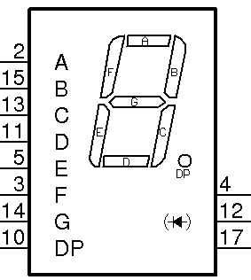
Creating a Design
device SevenSeg is
attr refPrefix = “LD”;
attr pkg_type = “SA08-21”;
pin[1:8] segments = {2,15,13,11, 5,3,14,10};
pin[1:3] anode = {4,12,17};
end device;
LD?
₂
₁₅
₁₃
₁₁
₅
₃
₄
₁₄
₁₂
₁₀
₁₇
SA08-21

Slide 29
Creating a Design
device SevenSeg is
attr refPrefix = “LD”;
attr pkg_type = “SA08-21”;
pin[1:8] segments = {2,15,13,11, 5,3,14,10};
pin[1:3] anode = {4,12,17};
end device;
LD?
₂
₁₅
₁₃
₁₁
₅
₃
₄
₁₄
₁₂
₁₀
₁₇
SA08-21

Slide 30
PHDL Example Design
design ssControl is
device Resistor is
attr refPrefix = “R”;
attr pkg_type = “M0805”;
pin a = {1};
pin b = {2};
end device;
device Switch is
attr refPrefix = “SW”;
attr pkg_type = “MS243”;
pin a = {1}; pin b = {2};
end device;
device Battery is
attr refPrefix = “G”;
attr pkg_type = “1V60R”;
attr value = “9V”;
pin pos = {2}; pin neg = {1};
end device;
device SevenSeg is
attr refPrefix = “LD”;
attr pkg_type = “MS243”;
pin[1:8] segments = {2,15,13,11, 5,3,14,10};
pin[1:3] anode = {4,12,17};
end device;
net gnd, vcc;
net[1:8] segs, r2sw;
begin
inst source of Battery is
pos = vcc;
neg = gnd;
end inst;
inst segment of SevenSeg is
segments = segs;
anode = <vcc>;
end inst;
inst(1:8) swArray of Switch is
combine.a = r2sw;
combine.b = segs;
end inst;
inst(1:8) rArray of Resistor is
newattr value = “120”;
combine.a = r2sw;
each.b = gnd;
end inst;
end design;

Slide 31
PHDL Example Design
design ssControl is
device Resistor is
attr refPrefix = “R”;
attr pkg_type = “M0805”;
pin a = {1};
pin b = {2};
end device;
device Switch is
attr refPrefix = “SW”;
attr pkg_type = “MS243”;
pin a = {1}; pin b = {2};
end device;
device Battery is
attr refPrefix = “G”;
attr pkg_type = “1V60R”;
attr value = “9V”;
pin pos = {2}; pin neg = {1};
end device;
device SevenSeg is
attr refPrefix = “LD”;
attr pkg_type = “MS243”;
pin[1:8] segments = {2,15,13,11, 5,3,14,10};
pin[1:3] anode = {4,12,17};
end device;
net gnd, vcc;
net[1:8] segs, r2sw;
begin
inst source of Battery is
pos = vcc;
neg = gnd;
end inst;
inst segment of SevenSeg is
segments = segs;
anode = <vcc>;
end inst;
inst(1:8) swArray of Switch is
combine.a = r2sw;
combine.b = segs;
end inst;
inst(1:8) rArray of Resistor is
newattr value = “120”;
combine.a = r2sw;
each.b = gnd;
end inst;
end design;

Slide 32
PHDL Example Design
design ssControl is
device Resistor is
attr refPrefix = “R”;
attr pkg_type = “M0805”;
pin a = {1};
pin b = {2};
end device;
device Switch is
attr refPrefix = “SW”;
attr pkg_type = “MS243”;
pin a = {1}; pin b = {2};
end device;
device Battery is
attr refPrefix = “G”;
attr pkg_type = “1V60R”;
attr value = “9V”;
pin pos = {2}; pin neg = {1};
end device;
device SevenSeg is
attr refPrefix = “LD”;
attr pkg_type = “MS243”;
pin[1:8] segments = {2,15,13,11, 5,3,14,10};
pin[1:3] anode = {4,12,17};
end device;
net gnd, vcc;
net[1:8] segs, r2sw;
begin
inst source of Battery is
pos = vcc;
neg = gnd;
end inst;
inst segment of SevenSeg is
segments = segs;
anode = <vcc>;
end inst;
inst(1:8) swArray of Switch is
combine.a = r2sw;
combine.b = segs;
end inst;
inst(1:8) rArray of Resistor is
newattr value = “120”;
combine.a = r2sw;
each.b = gnd;
end inst;
end design;

Slide 33
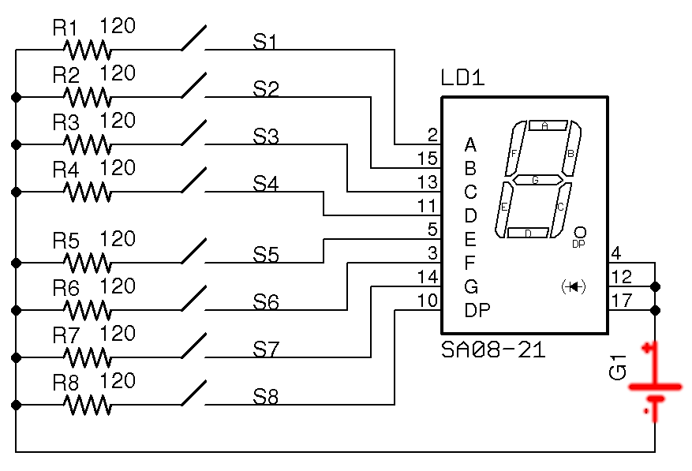
Creating a Design
inst source of Battery is
pos = vcc;
neg = gnd;
end inst;

Slide 34
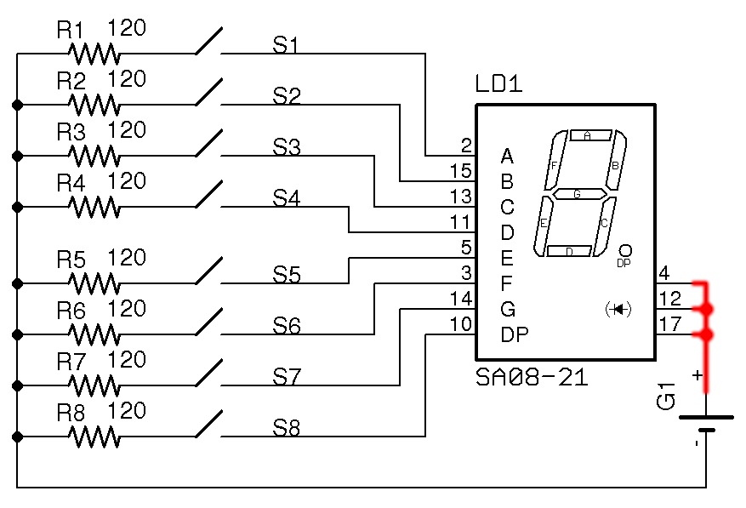
Creating a Design
inst source of Battery is
pos = vcc;
neg = gnd;
end inst;

Slide 35
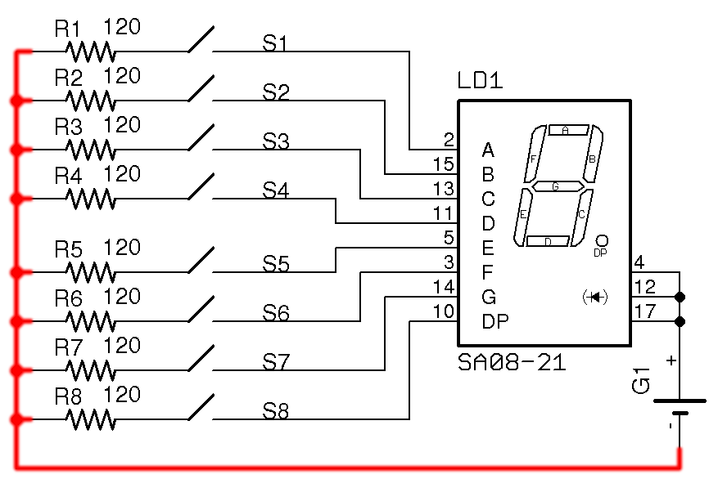
Creating a Design
inst source of Battery is
pos = vcc;
neg = gnd;
end inst;

Slide 36
PHDL Example Design
design ssControl is
device Resistor is
attr refPrefix = “R”;
attr pkg_type = “M0805”;
pin a = {1};
pin b = {2};
end device;
device Switch is
attr refPrefix = “SW”;
attr pkg_type = “MS243”;
pin a = {1}; pin b = {2};
end device;
device Battery is
attr refPrefix = “G”;
attr pkg_type = “1V60R”;
attr value = “9V”;
pin pos = {2}; pin neg = {1};
end device;
device SevenSeg is
attr refPrefix = “LD”;
attr pkg_type = “MS243”;
pin[1:8] segments = {2,15,13,11, 5,3,14,10};
pin[1:3] anode = {4,12,17};
end device;
net gnd, vcc;
net[1:8] segs, r2sw;
begin
inst source of Battery is
pos = vcc;
neg = gnd;
end inst;
inst segment of SevenSeg is
segments = segs;
anode = <vcc>;
end inst;
inst(1:8) swArray of Switch is
combine.a = r2sw;
combine.b = segs;
end inst;
inst(1:8) rArray of Resistor is
newattr value = “120”;
combine.a = r2sw;
each.b = gnd;
end inst;
end design;

Slide 37
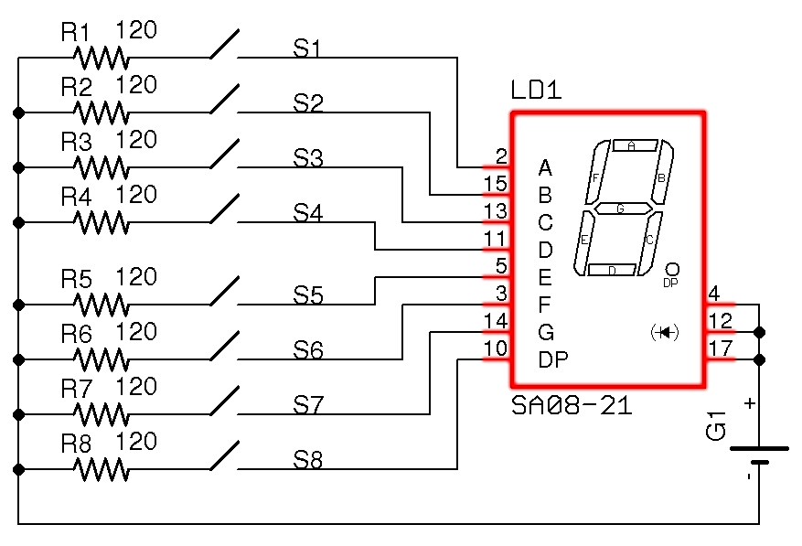
Creating a Design
inst segment of SevenSeg is
segments = segs;
anode = <vcc>;
end inst;

Slide 38
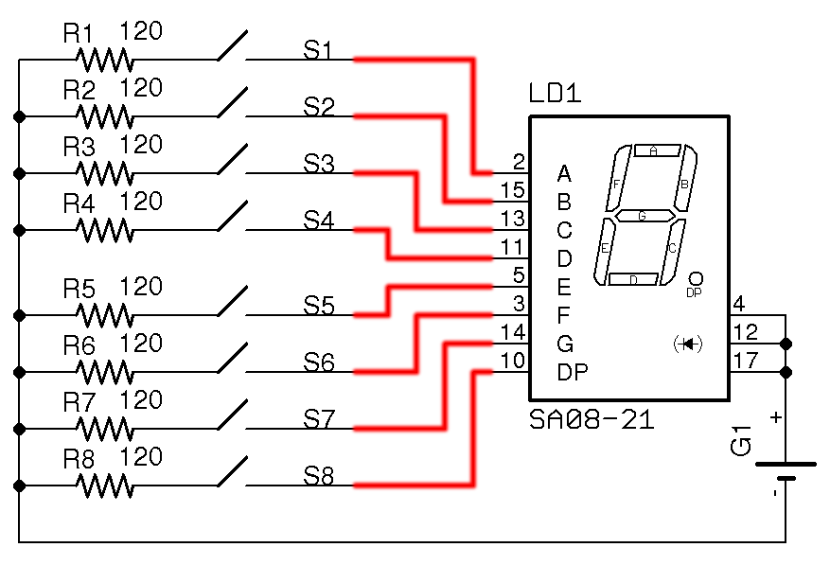
Creating a Design
inst segment of SevenSeg is
segments = segs;
anode = <vcc>;
end inst;

Slide 39
Creating a Design
inst segment of SevenSeg is
segments = segs;
anode = <vcc>;
end inst;

Slide 40
PHDL Example Design
design ssControl is
device Resistor is
attr refPrefix = “R”;
attr pkg_type = “M0805”;
pin a = {1};
pin b = {2};
end device;
device Switch is
attr refPrefix = “SW”;
attr pkg_type = “MS243”;
pin a = {1}; pin b = {2};
end device;
device Battery is
attr refPrefix = “G”;
attr pkg_type = “1V60R”;
attr value = “9V”;
pin pos = {2}; pin neg = {1};
end device;
device SevenSeg is
attr refPrefix = “LD”;
attr pkg_type = “MS243”;
pin[1:8] segments = {2,15,13,11, 5,3,14,10};
pin[1:3] anode = {4,12,17};
end device;
net gnd, vcc;
net[1:8] segs, r2sw;
begin
inst source of Battery is
pos = vcc;
neg = gnd;
end inst;
inst segment of SevenSeg is
segments = segs;
anode = <vcc>;
end inst;
inst(1:8) swArray of Switch is
combine.a = r2sw;
combine.b = segs;
end inst;
inst(1:8) rArray of Resistor is
newattr value = “120”;
combine.a = r2sw;
each.b = gnd;
end inst;
end design;

Slide 41
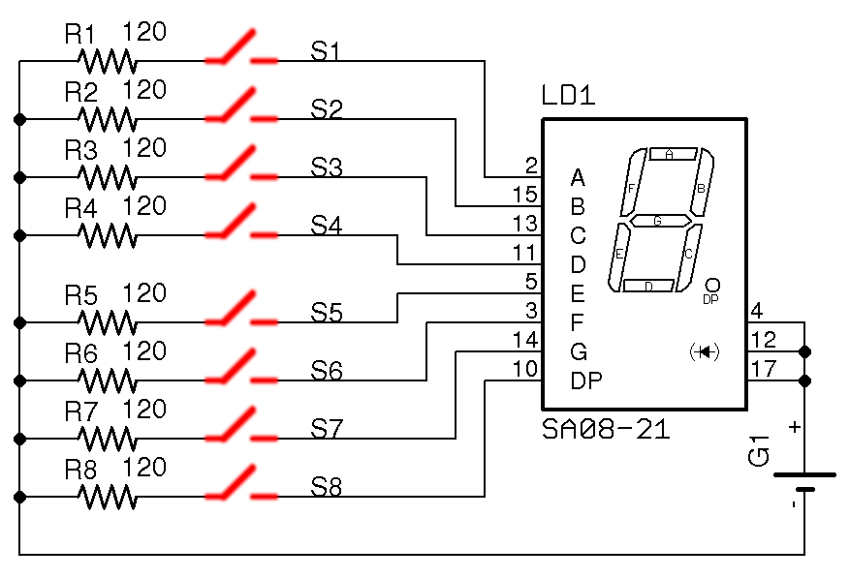
Creating a Design
inst(1:8) swArray of Switch is
combine.a = r2sw;
combine.b = segs;
end inst;

Slide 42
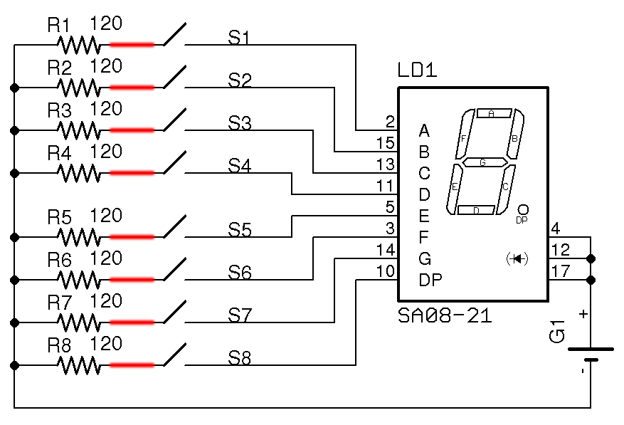
Creating a Design
inst(1:8) swArray of Switch is
combine.a = r2sw;
combine.b = segs;
end inst;

Slide 43
Creating a Design
inst(1:8) swArray of Switch is
combine.a = r2sw;
combine.b = segs;
end inst;

Slide 44
PHDL Example Design
design ssControl is
device Resistor is
attr refPrefix = “R”;
attr pkg_type = “M0805”;
pin a = {1};
pin b = {2};
end device;
device Switch is
attr refPrefix = “SW”;
attr pkg_type = “MS243”;
pin a = {1}; pin b = {2};
end device;
device Battery is
attr refPrefix = “G”;
attr pkg_type = “1V60R”;
attr value = “9V”;
pin pos = {2}; pin neg = {1};
end device;
device SevenSeg is
attr refPrefix = “LD”;
attr pkg_type = “MS243”;
pin[1:8] segments = {2,15,13,11, 5,3,14,10};
pin[1:3] anode = {4,12,17};
end device;
net gnd, vcc;
net[1:8] segs, r2sw;
begin
inst source of Battery is
pos = vcc;
neg = gnd;
end inst;
inst segment of SevenSeg is
segments = segs;
anode = <vcc>;
end inst;
inst(1:8) swArray of Switch is
combine.a = r2sw;
combine.b = segs;
end inst;
inst(1:8) rArray of Resistor is
newattr value = “120”;
combine.a = r2sw;
each.b = gnd;
end inst;
end design;

Slide 45
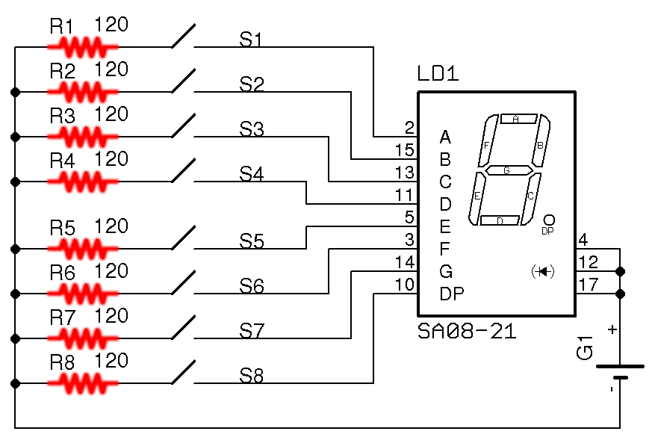
Creating a Design
inst(1:8) rArray of Resistor is
newattr value = “120”;
combine.a = r2sw;
each.b = gnd;
end inst;

Slide 46
Creating a Design
inst(1:8) rArray of Resistor is
newattr value = “120”;
combine.a = r2sw;
each.b = gnd;
end inst;

Slide 47
Creating a Design
inst(1:8) rArray of Resistor is
newattr value = “120”;
combine.a = r2sw;
each.b = gnd;
end inst;

Slide 48
Creating a Design
inst(1:8) rArray of Resistor is
newattr value = “120”;
combine.a = r2sw;
each.b = gnd;
end inst;

Slide 49
PHDL Example Design
design ssControl is
device Resistor is
attr refPrefix = “R”;
attr pkg_type = “M0805”;
pin a = {1};
pin b = {2};
end device;
device Switch is
attr refPrefix = “SW”;
attr pkg_type = “MS243”;
pin a = {1}; pin b = {2};
end device;
device Battery is
attr refPrefix = “G”;
attr pkg_type = “1V60R”;
attr value = “9V”;
pin pos = {2}; pin neg = {1};
end device;
device SevenSeg is
attr refPrefix = “LD”;
attr pkg_type = “MS243”;
pin[1:8] segments = {2,15,13,11, 5,3,14,10};
pin[1:3] anode = {4,12,17};
end device;
net gnd, vcc;
net[1:8] segs, r2sw;
begin
inst source of Battery is
pos = vcc;
neg = gnd;
end inst;
inst segment of SevenSeg is
segments = segs;
anode = <vcc>;
end inst;
inst(1:8) swArray of Switch is
combine.a = r2sw;
combine.b = segs;
end inst;
inst(1:8) rArray of Resistor is
newattr value = “120”;
combine.a = r2sw;
each.b = gnd;
end inst;
end design;

Slide 50
PHDL Example Design
design ssControl is
include “parts.phdl”;
net gnd, vcc;
net[1:8] segs, r2sw;
begin
inst source of Battery is
pos = vcc;
neg = gnd;
end inst;
inst segment of SevenSeg is
segments = segs;
anode = <vcc>;
end inst;
inst(1:8) swArray of Switch is
combine.a = r2sw;
combine.b = segs;
end inst;
inst(1:8) rArray of Resistor is
newattr value = “120”;
combine.a = r2sw;
each.b = gnd;
end inst;
end design;

Slide 51
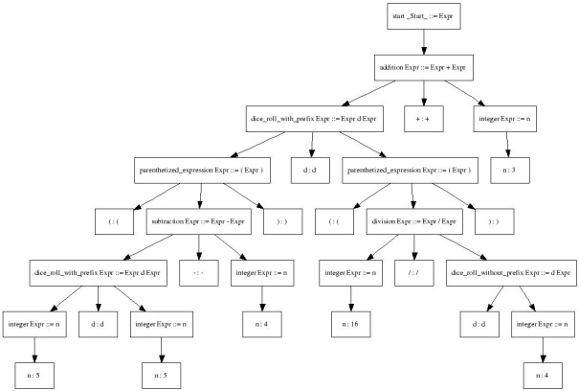
How PHDL Works
~/user/brad/phdl/projects
$java phdl.Compile <file_name>.phdl [switches]
Abstract Syntax Tree (AST)
PHDL source
Lexer
Parser
Tree Parser
ANTLR framework
Command line switches
Netlist
Bill of Materials
Component List
Layout Directions
XML
Tool-specific Scripts
Analyzer / Generator
Output files

Slide 52


Targeted Design Flows
EAGLE PCB
FPGA-based Motor Controller - BYU
Mentor Graphics PADS
AD9739 High Speed DAC FMC board – Pete Dudley

Slide 53
BYU Proof of Concept Board
FPGA-based motor controller (2-axes)
Spartan3 400K 144-pin QFP implements:
32-bit position, vel. and accel. registers per axis
Programmable PID filters, sampling intervals
Trapezoidal velocity profile generators
Packet router over RS232 to host PC application
Supporting hardware
500+ CPR encoder feedback resolution
PWM brushless and brushed motor drives
The usual JTAG, Flash ROM, GPIO, etc.

Slide 54
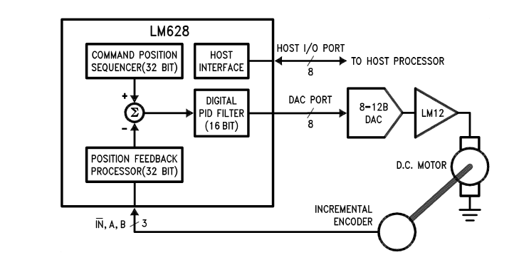
Motor Controller Board
Single Axis Block Diagram
RS232 Host Application
MOTOR DRIVERS
FPGA VHDL
Hardware Outside FPGA

Slide 55
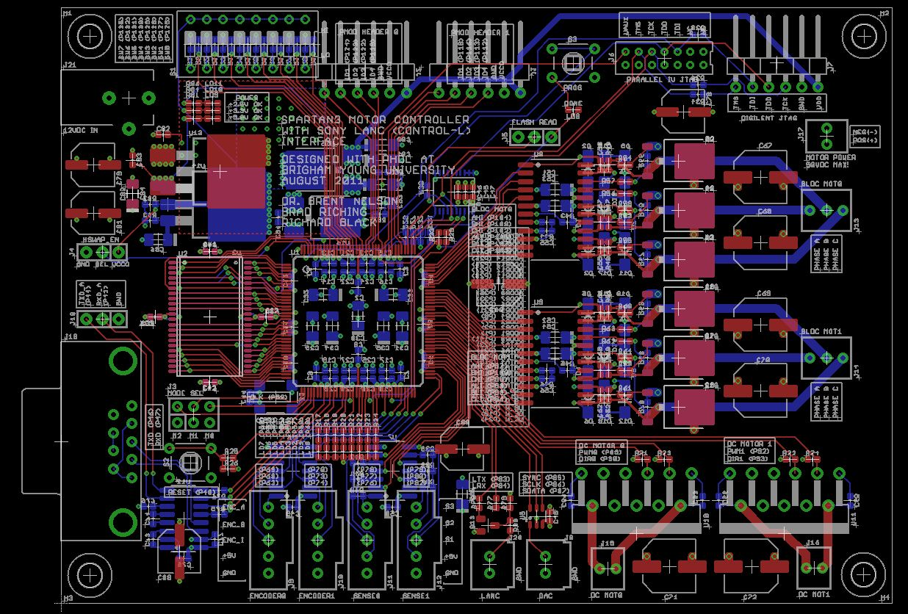
Motor Controller Board
Final Layout in EAGLE

Slide 56
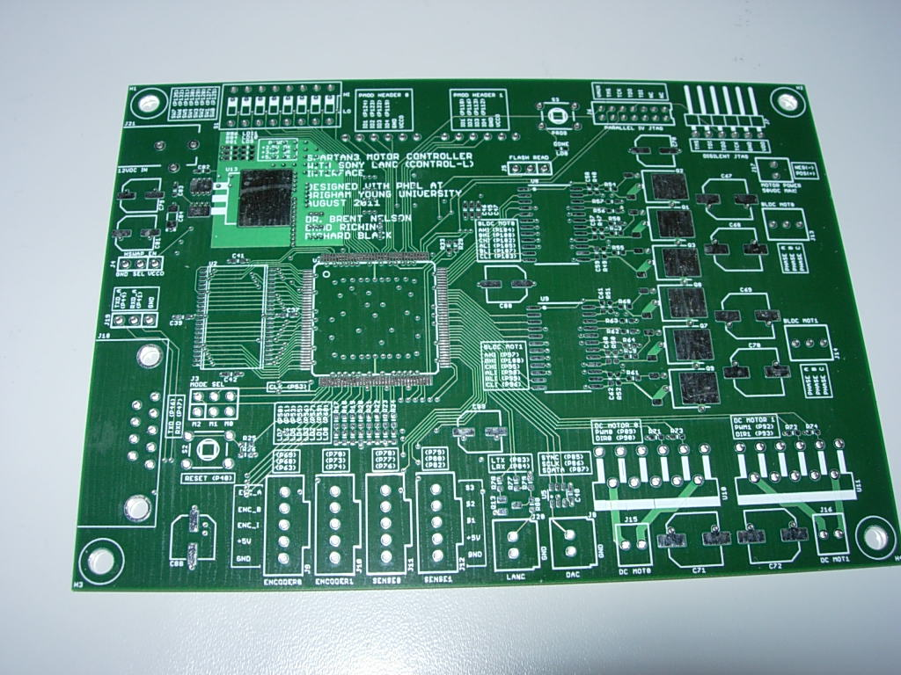
Motor Controller Board
Back From Manufacturing

Slide 57
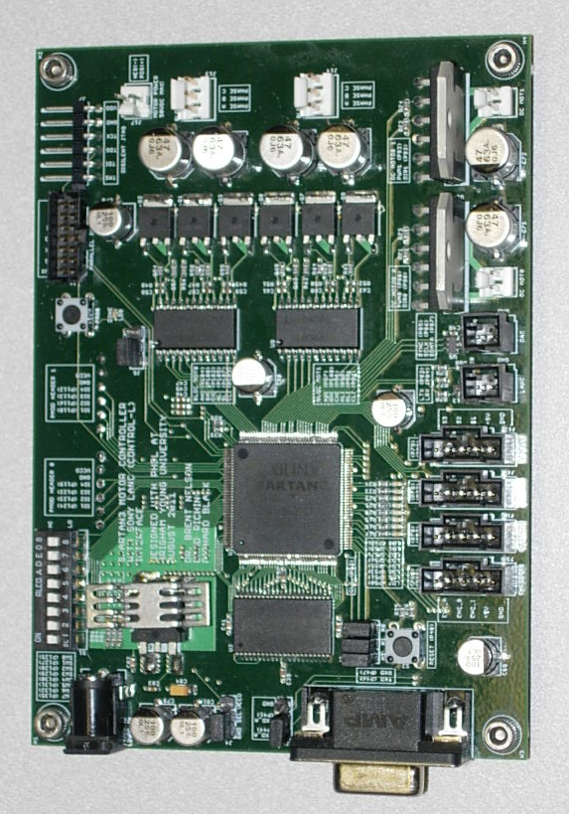
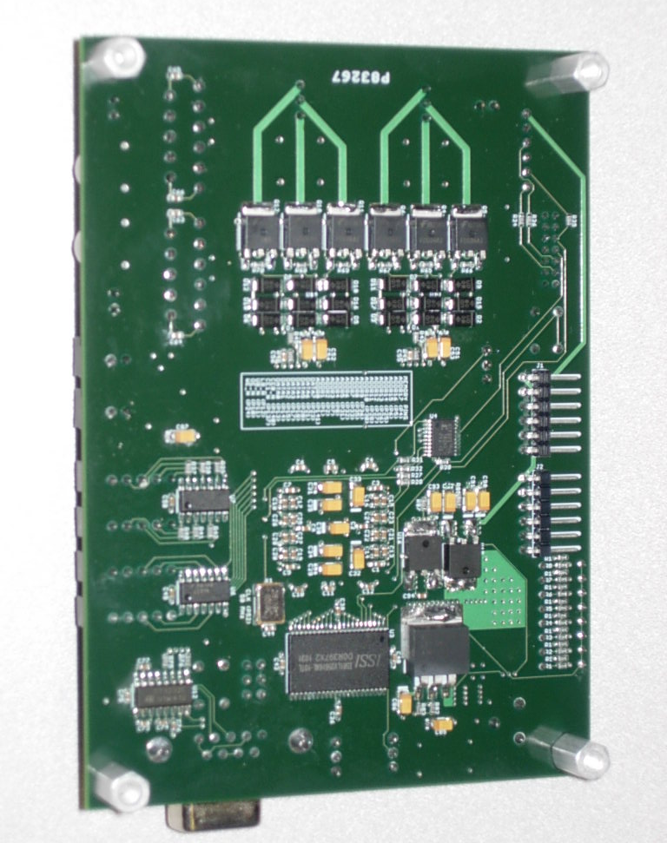
Motor Controller Board
Assembled
Top
Bottom

Slide 58
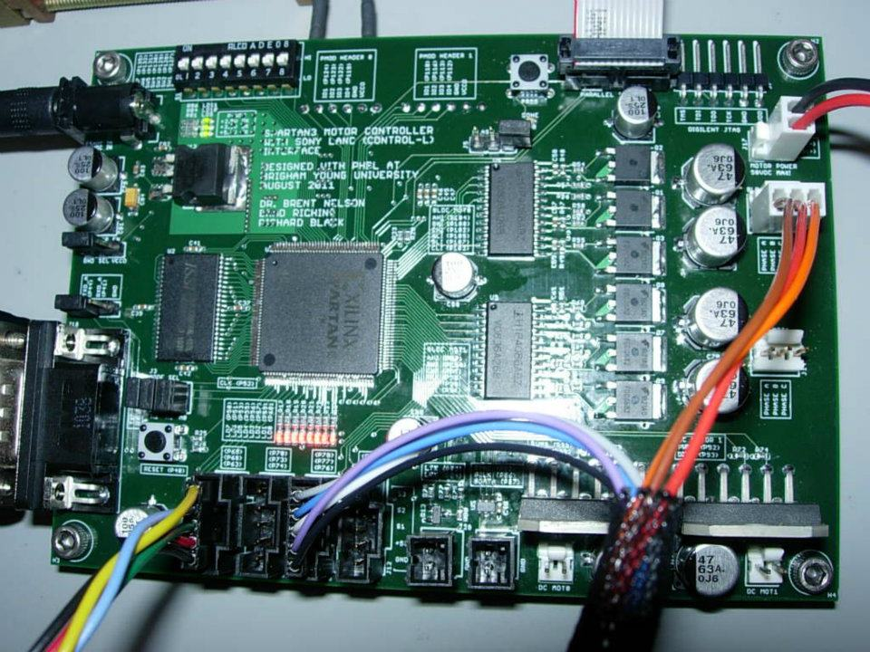
Motor Controller Board
First PCB Built using PHDL

Slide 59
Motor Controller Board
JTAG
Power Supply
12VDC IN:
To 5V, 3.3V, 2.5V, 1.2V
Motor Power 58VDC MAX
Brushless Drive (x2)
RS232
Brushed Drive (x2)
Encoder Feedback

Slide 60
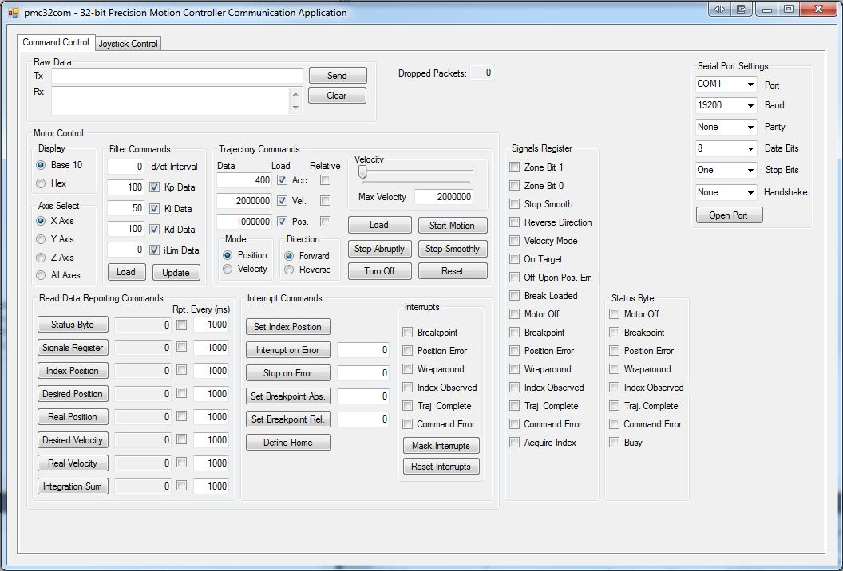
Motor Controller Board
Host Application Interface (C#)
Serial Config
Raw Data Monitoring
Positioning
Commands
Reporting Commands
Internal State Registers

Slide 61


Automatic Device Generation
FPGA VHDL Design
Location Constraints
PHDL Device Declaration
library ieee;
use ieee.numeric_std.all;
use ieee.std_logic_1164.all;
entity fpga is
port(
clk : in std_logic;
rst : in std_logic;
-- RS232 serial ports
rxd : in std_logic;
txd : out std_logic;
rxd_a : in std_logic;
txd_a : out std_logic;
-- 12-bit DAC
sclk : out std_logic;
sync : out std_logic;
sdata : out std_logic
data : out std_logic_vector(7 downto 0)
.
.
.
);
end entity fpga;
device fpga is
attr refPrefix = "U";
attr pkg_type = "tq144";
attr mfgr = "XILINX";
attr partNumber = "xc3s400-4tq144";
// User I/O pins.
pin clk = {P52};
pin rst = {P40};
pin rxd = {P47};
pin rxd_a = {P41};
pin txd = {P46};
pin txd_a = {P44};
pin sclk = {P86};
pin sdata = {P87};
pin sync = {P85};
pin[7:0] data = {P23,P21,P20,P18...};
.
.
.
end;
#fpga.ucf
LOC “clk” = P52;
LOC “rst” = P40:
LOC “rxd” = P47;
LOC “rxd_a” = P41;
.
.
.
Synthesis, PAR,
csv2phdl

Slide 62

Automatic Device Generation
Automated FPGA Device Declaration from HDL
HDL
fpga.csv
csv2phdl
fpga.phdl
PHDL Device Declaration
fpga.vhdl
fpga.ucf
Synthesis, PAR
PHDL Source Code
design myDes is
include “fpga.phdl”;
begin
…
end design;
Revisions

Slide 63
Motor Controller Board
FPGA Instance
inst fpga_inst of fpga is
newattr libName = "xilinx_devices";
partnumber = "122-1717-ND";
newattr supplier = "DIGI-KEY";
newattr cost = "21.95";
// Signal pins from FPGA design.
clk = clk;
rst = rst;
rxd = rxd;
rxd_a = rxd_a;
txd = txd;
txd_a = txd_a;
sclk = sclk;
sdata = sdata;
sync = sync;
data = data;
.
.
.
end;

Slide 64
Motor Controller Board
~1200 lines of PHDL (25 pages of code)
30 device declarations
6 library files
672 nets

Slide 65
Motor Controller Board
Bill of Materials (CSV)

Slide 66
The Group Construct
group "SWITCHES" is
inst fpga_switches of dipswitch is
a = <vcco>;
b = sw_res;
end;
inst(7:0) sw_pulldown of R0603 is
value = "4.7k";
partNumber = "P4.7KGCT-ND";
combine.a = sw_res;
each.b = gnd;
end;
inst(7:0) sw_lim of R0603 is
value = "4.7k";
partNumber = "P4.7KGCT-ND";
combine.a = sw_res;
combine.b = sw;
end;
end;
Group name
Initial Arrayed Layout

Slide 67
Why PHDL? (the longer version)
Open format
Any text tools can read and manipulate
Design files do not get corrupted
Easily shared, exchanged, emailed
Design files forward/backward compatible across tool revisions

Slide 68
Why PHDL?
IDEs
Templates and auto completion
Color syntax highlighting
Search, search-and-replace
Scripting
Example: Eclipse

Slide 69
Why PHDL?
SCCS (source code control system)
Shared repository for designs and part libraries
Design versions, change tracking/documentation
Diff, revert
Collaboration
Reusability
Cross probing

Slide 70
Why PHDL?
Hierarchy
Focus on functionality rather than looks of schematic
Easy to mis-wire in graphics
Rats nests
Missed endpoints
High pin count packages span multiple pages
Dangling wires across schematic pages
Non-electrical parts trivial to add

Slide 71
Why PHDL?
Automation
Higher level constructs
Arrays, hierarchy
Refdes handling
DRC available to user due to open format
Lint-like tools easily written
Automatic generation of design files
Example: device generation from UCF file for FPGAs

Slide 72
What’s Next?
PHDL 2.0
Hierarchy support
Pin directions and DRC
IDE Eclipse plugin
Instance template generator
Syntax coloring
Content assist
Hierarchy browser
Refactoring
Additional tool flows

